Slide 1

How to Target Bellabeat’s Users – A Study For Google data analytics
Maryam Safa

Slide 2
Summary
SETTING: As per Google:
“Welcome to the Bellabeat data analysis case study! In this case study, you will perform many real-world tasks of a junior data analyst. You will imagine you are working for Bellabeat, a high-tech manufacturer of health-focused products for women, and meet different characters and team members. In order to answer the key business questions, you will follow the steps of the data analysis process: ask, prepare, process, analyze, share, and act. Along the way, the Case Study Roadmap tables — including guiding questions and key tasks — will help you stay on the right path.”

Slide 3
ASk
All the data used is from the Google Analytics Certificate course, available on Kaggle.
Any insights and conclusions could help drive future marketing decisions.
How to drive increase traffic and promote app usage?
Identify key trends in users.
Stakeholders:
Urska Srsen: CCO and Co-founder Bellabear
Sando Mur: Executive Team Member, Co-founder Bellabeat
Bellabeat Marketing Analytics Team

Slide 4
prepare
Data is open-source.
Data collected between 4/12/2016 to 5/12/2106 from 30 Fitbit users who consented to the submission of data.
In total there are 18 .csv files which give us different information like sleep data, calories, etc.,
It is important to note that the sample size is very small and old. This is not a population analysis. For more accurate insights, we would need a larger and more current dataset.

Slide 5
process
We use Jupyter Notebooks for the analysis. The accompanying .ipynb file, we loaded the required libraries and files:
We only use ‘dailyActivity_merged.csv’, ‘weightLogInfo_merged.csv’, ‘dailySteps_merged.csv’, and ‘sleepDay_merged.csv’ for our analysis.
We first check all the datatypes of columns, if there are any null values and the presence of any duplicates. Non-null values and duplicates are then dropped.
We create manipulate the data. More detailed information in the .ipynb file.
We categorise users based on their activity, their sleep patterns.
We also see the users’ device usage tendencies.

Slide 6
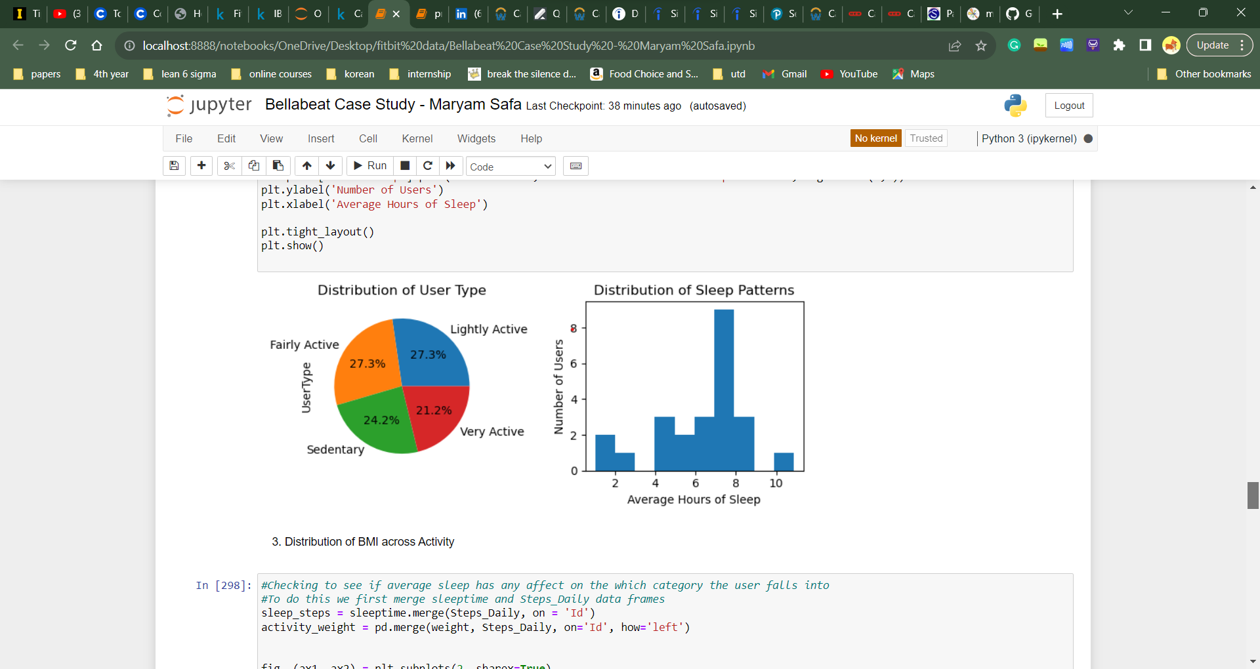
analyze
Data is plotted using mathplotlib library in python.
We see the sample population is about equally divided into sedentary, lightly active, fairly active, and very active users.
A look at sleep distribution patterns tells us that the population is negatively skewed.

Slide 7
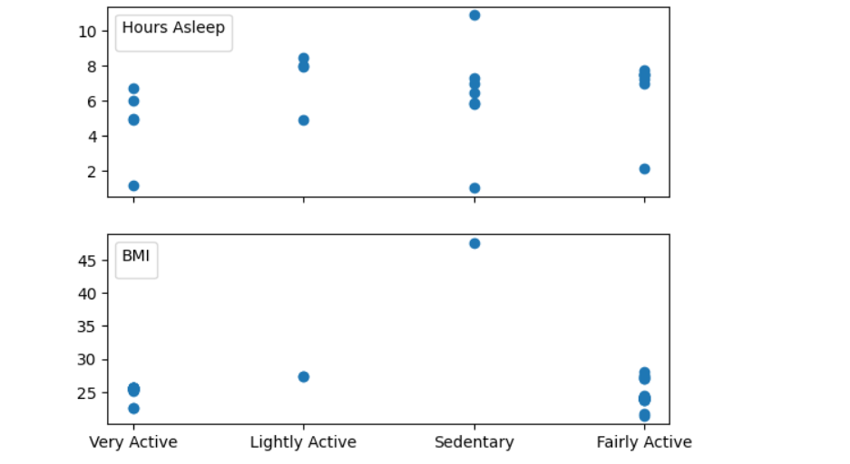
ANalyze
A distribution of the population based on their activity tells us that:
Although there is limited data which can heavily skew the results, we can see a trend that very active and fairly active users (so users who walk greater than 7500 steps per day on average) are the people most likely to have a healthy BMI(18.5-24.9). Only about 24% of the users logged their weight, which is not enough to make any concrete conclusions.
On ignoring outliers, we can say that most users got between 4-8 hrs of sleep, most being sedentary users.
Only one sedentary user logged their weight, which could mean that these users tend to not mention their weight.

Slide 8
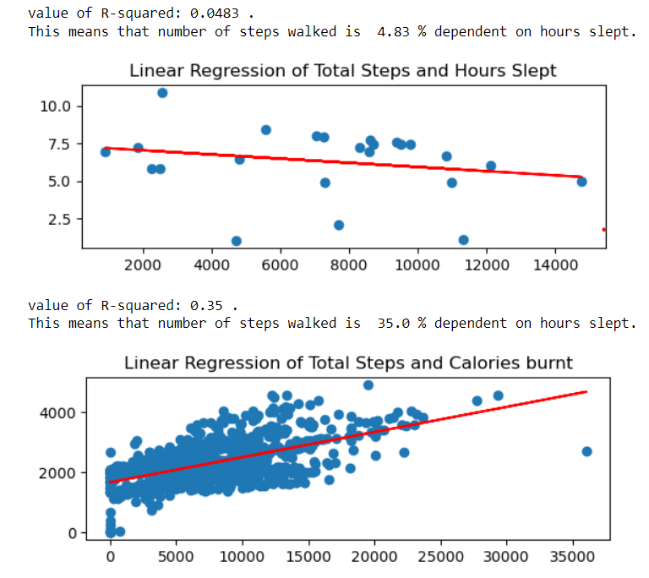
analyze
Upon linear regression analysis:
There was no observed correlation between hours slept(x) and total steps taken (y).
There was no dependence of sleep patterns on steps walked.
There was moderate correlation between total steps taken (x) and calories burned(y).

Slide 9
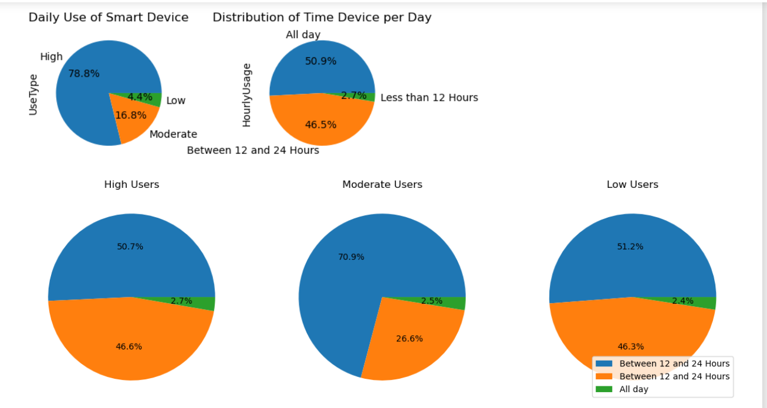
analyze
We see that that about 79% of users used their fitbits for more than 30 days, lending validity to our analyses.
About 97% of the users used their devices more than 12 hours.
About 98% of the users who used fitbits for more than 30 days, also had their devices on their person for more than 12 hours.
Even though the sample size is small, this lends credibility to our conclusions.

Slide 10
Limitations
Data is ambiguous about the sex of users, which can take away from results.
Users did not wear their devices all day which skewed our results.
The sample size was very small, when it came to sleep tracking.
A more current and larger sample size would improve the analyses.

Slide 11
act
Incorporate a referral program: give incentives for current users to share Bellabeat app with their acquaintances to increase our user-base.
Reward System: When users walk more than 7500 steps a day, they add points to an ongoing leveling system. This system accumulates points when sleep and steps targets are met.
Daily Notifications: Send these when users reach their goals, or are falling behind. Send these notifications when the users are more likely to exercise.
Articles and Features: Incorporate these to help users sleep, reach their weight goals, and exercise goals.
Encourage users to have their devices always.

